Slide 1
An IoT Based Approach To Design An Effective Air Pollution Monitoring System
Project Report
Submitted By
Aliul Nadab, Roll- 1220CMSH-0034, Reg. No. 121-1117-0725-20
Rohit Neogi, Roll- 1220CMSH-0046, Reg. No. 121-1111-0737-20
Tushar Ghosh, Roll- 1220CMSH-0061, Reg. No. 121-1115-0752-20
Department of Computer Science
Gour Mahavidyalaya
Malda
August, 2023

Slide 2
Objective
The objective of our project to find out the time when the air feels fresh or less polluted with the help of ARDUINO UNO & some gas sensor.

Slide 3
Table of Contents
Introduction
Methodology
Architecture
Working Principle of Proposed Model
Result
Conclusion
References

Slide 4
Introduction
What is air pollution ?
How is air polluted?
How it affects the environment?
How to detect the polluted air?

Slide 5
Methodology
In this project we have used:
Arduino UNO
Breadboard
Gas sensors
1) MQ-6 (Acetone)
2)MQ-9 (CO, Toluene)
3) MQ-135 (CO₂, NH₄)
Approx. Average values of the gas(in ppm)
CO₂
CO
Toluene
NH₄
Acetone
400 ppm
200 ppm
59.8 ppm
400 ppm
200 ppm

Slide 6
Start
Load Libraries on the sensors and define pins
Check Connection
IF No
IF yes
Error shows in serial monitor
Manually type the data and store as csv file and visualize it
Display data on serial monitor using Arduino Uno
Collect data from MQ6, MQ9, MQ135 sensors

Slide 7
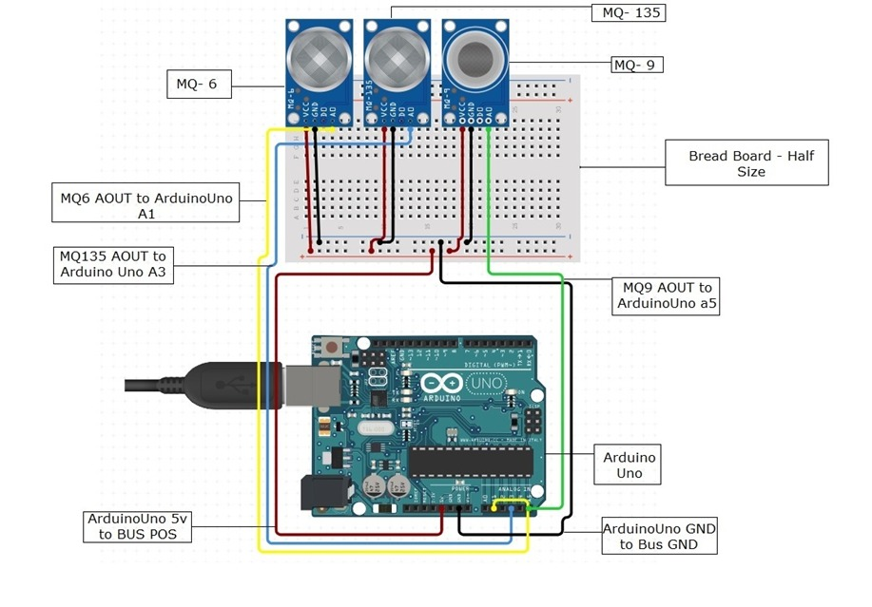
Architecture

Slide 8
Functionalities
Setup the connection between ARDUINO & gas sensors
Coding
Collect the data from sensors and note down into a file
Make the average of the data to find out the average value of the data set with respect to time.
With ML Data visualization technique we make data set visual to see where and in which time the quality of air is less polluted.
Save the result

Slide 9
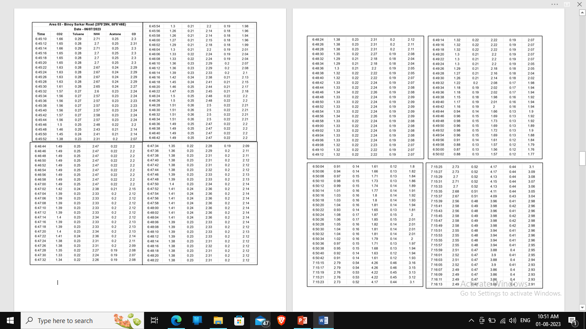
Result

Slide 10
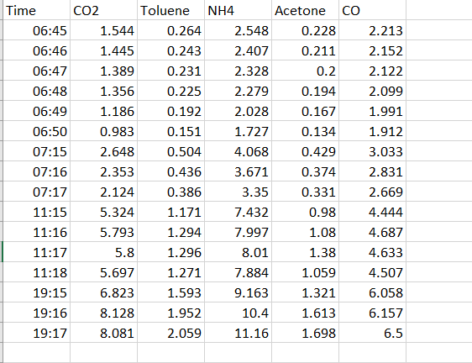
For making Data Visualization We make Average this dataset to per minute time wise

Slide 11
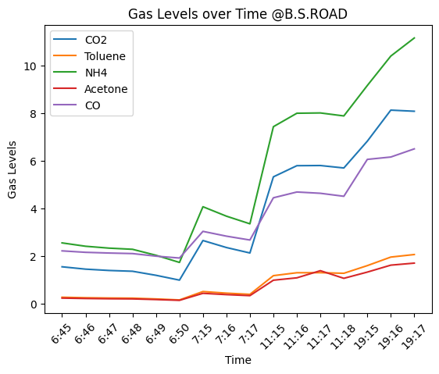
Figure 5 . Air quality of B.S.Road

Slide 12
In this study, we found that urban areas like Rathbari and B.S. Road have higher air pollution levels. This is mainly because of the larger population, industrial activities, and heavy traffic in these areas. On the other hand, rural areas like Sujapur may have higher levels of certain pollutants due to agricultural activities.To improve air quality and protect the health of people living in these regions, it is important to implement targeted pollution control measures. Continuous monitoring of air quality is essential to track the effectiveness of these measures over time and ensure a healthier environment for everyone.
Conclusion
The air pollution monitoring system project has been successful in achieving its main objective, which is to monitor air quality in industrial and urban areas. The system utilizes IoT (Internet of Things) technology, gas sensors, Arduino microcontroller to continuously measure, analyze, and log air quality data.

Slide 13
Extra Functionalities:
In this project we can also add some extra features . We can use more gas sensors to detect more gases , like MQ-2 gas sensor can detect smoke. We can also use only one sensor to detect a particular gas more accurately.
A Wi-Fi module can also be connect if we want to send the data as a mail, app, website or text.
We can also predict the quality of air, when or in which place it will be less polluted from collecting more data and using some ML Algorithm.
By adding an alarm system we can alert , if the quality of air is not so good.

Slide 14
Reference
https://www.who.int/health-topics/air-pollution#tab=tab_1
Matthews V.O., Uzairue S.I., Noma-Osaghae E., and Nwukor F., Design and Simulation of a Smart Automated Traffic System in a Campus Community.", International Journal of Emerging Technologies and Innovative Research (www.jetir.org | UGC and issn Approved), ISSN:2349-5162, 5 (8), 2018, pp. 492-497, Available at: http://www.jetir.org/papers/JETIR1807794.pdf.
https://en.wikipedia.org/wiki/Air_pollution
https://www.unep.org/news-and-stories/story/six-reasons-why-healthy-environment-should-be-human-right
Environmental and Health Impacts of Air Pollution: A Review -Ioannis Manisalidis,^{1,2,*†} Elisavet Stavropoulou,^{3,*†} Agathangelos Stavropoulos,^{4,†} and Eugenia Bezirtzoglou
https://pollution.ucr.edu/primary-vs-secondary#:~:text=Primary%20air%20pollutants%3A%20Pollutants%20that,lower%20atmosphere%20by%20chemical%20reactions.
Ambient (outdoor) Air Pollution - https://www.who.int/news-room/fact-sheets/detail/ambient-(outdoor)-air-quality-and-health
The cost of a polluted environment: 1.7 million child deaths a year, says WHO|6 March 2017 |News release| https://www.who.int/news/item/06-03-2017-the-cost-of-a-polluted-environment-1-7-million-child-deaths-a-year-says-who
The respiratory impacts of air pollution in children: Global and domestic (Taiwan) situation
I.-Ping Wu,^{a,d} Sui-Ling Liao,^{b,d} Shen-Hao Lai,^{c,d,∗} and Kin-Sun Wong^{c}

Slide 15
THANKS EVERYONE

